Slide 1


Project Title – Seasonal Agriculture Performance Analysis
Student Name : Sneha Ray
College Name- Maulana Abul Kalam Azad University of Technology, West Bengal
AICTE STU ID : STU6a63217bd69621784881531
9/6/2026
Annual Review
‹#›

Slide 2

PROBLEM STATEMENT
Agricultural performance varies across seasons due to changes in environmental conditions, farming practices, resource availability and market conditions.
The raw dataset does not directly reveal how these seasonal factors influence:
  Crop yield and production
  Resource usage and efficiency
  Disease and pest risk
  Revenue, cost and profitability
  This project analyses seasonal agricultural data to identify meaningful patterns, relationships, variations and differences that can support evidence-based agricultural planning.
9/6/2026
Annual Review
‹#›

Slide 3
PROJECT DESCRIPTION
This project performs a focused data analysis of 4,000 agricultural records across 28 variables.
The analysis covers three seasons:
Kharif , Rabi and Zaid
The project examines:
  Seasonal yield and production
  Environmental conditions
  Fertilizer, pesticide and water usage
  Water efficiency
  Disease/pest risk
  Revenue, cost and profit
  Crop-wise and state-wise seasonal performance
  Relationships between environmental/resource factors and yield
  Statistical significance of seasonal differences
  Outliers and unusual observations
  The dataset contains environmental, resource, production, economic and risk-related variables, which makes it suitable for a focused seasonal analysis
9/6/2026
Annual Review
‹#›

Slide 4
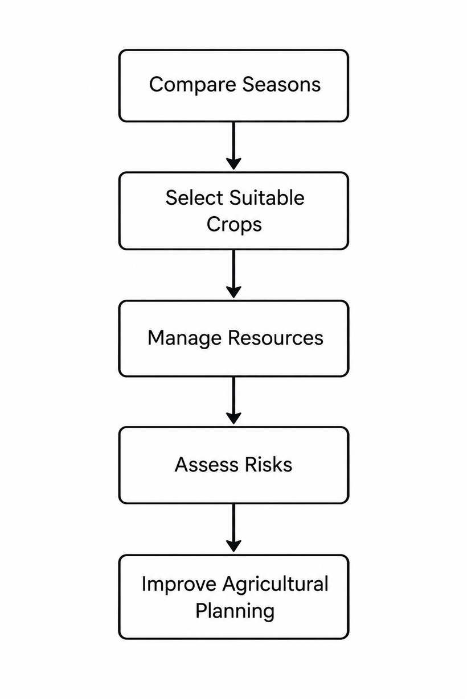

WHO ARE THE END USERS?
Primary End Users
  Farmers and agricultural planners
  Agricultural departments and policymakers
  Agricultural researchers
  Crop management and advisory organizations
  Agri-business and resource management teams
Use of Analysis
The findings can help users:
9/6/2026
Annual Review
‹#›

Slide 5

TECHNOLOGY USED
Programming Language
  Python
  Libraries
  Pandas
  NumPy
  Matplotlib
  Seaborn
  SciPy
  Scikit-learn
  Environment
  Google Colab / Jupyter Notebook
Analytical Techniques
  Data Cleaning
  Exploratory Data Analysis
  Univariate Analysis
  Bivariate Analysis
  Multivariate Analysis
  Correlation Analysis
  ANOVA
  Kruskal-Wallis Test
  IQR-based Outlier Detection
  Linear Regression
9/6/2026
Annual Review
‹#›
Notes:
5

Slide 6
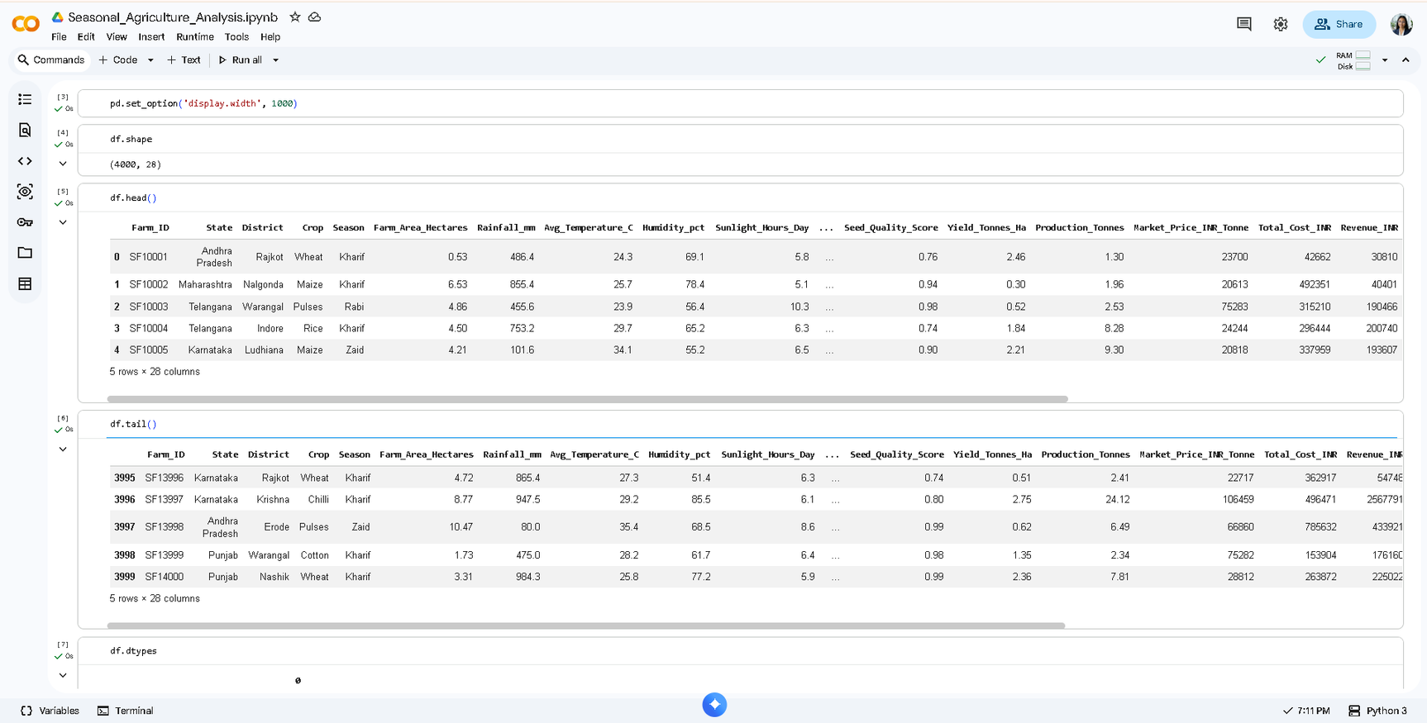
RESULTS
9/6/2026
Annual Review
‹#›

Slide 7
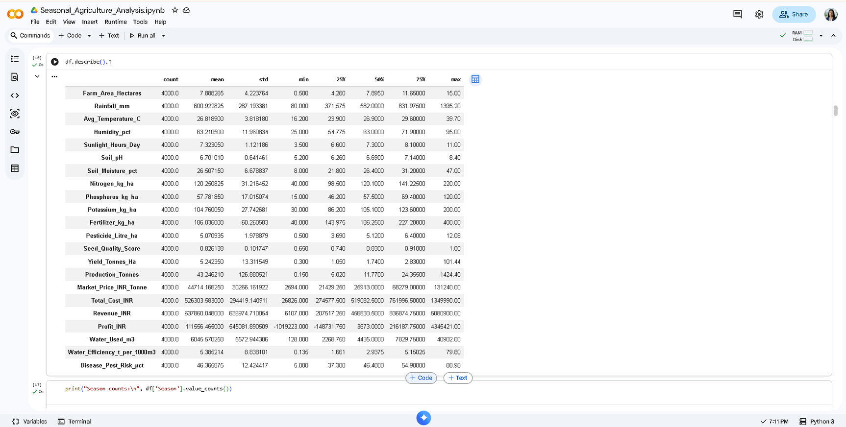
RESULTS
9/6/2026
Annual Review
‹#›

Slide 8
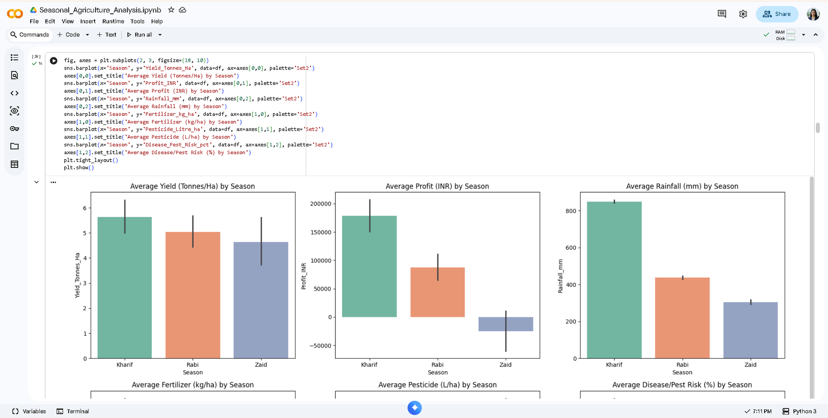
RESULTS
9/6/2026
Annual Review
‹#›

Slide 9
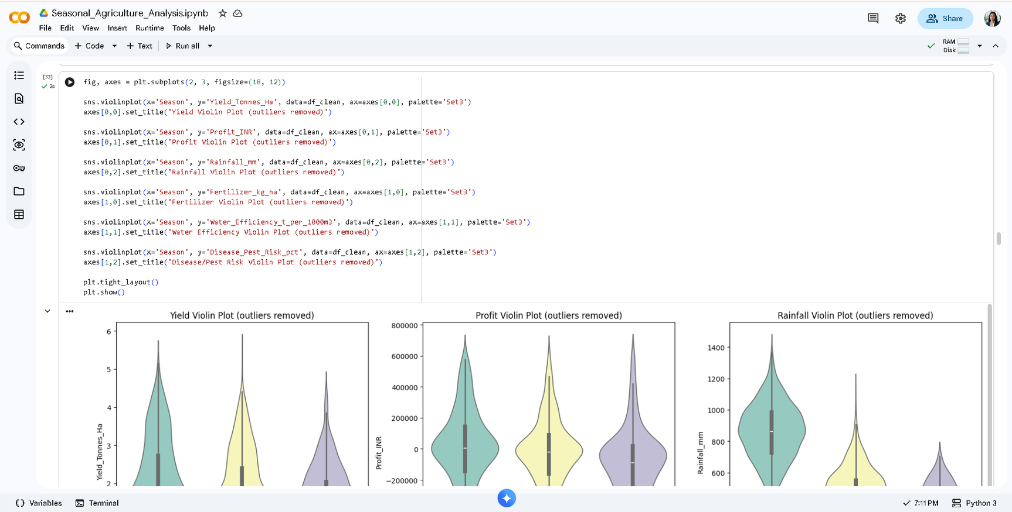
RESULTS
9/6/2026
Annual Review
‹#›

Slide 10
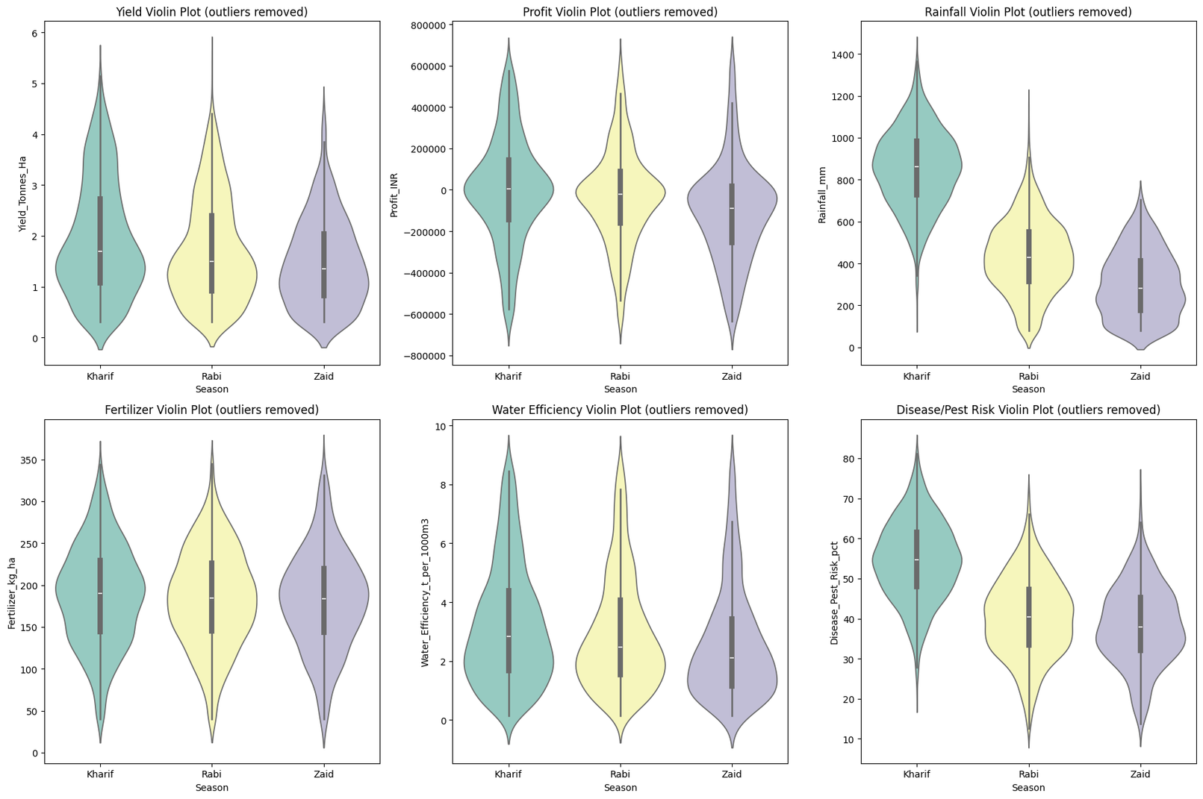
RESULTS
9/6/2026
Annual Review
‹#›

Slide 11
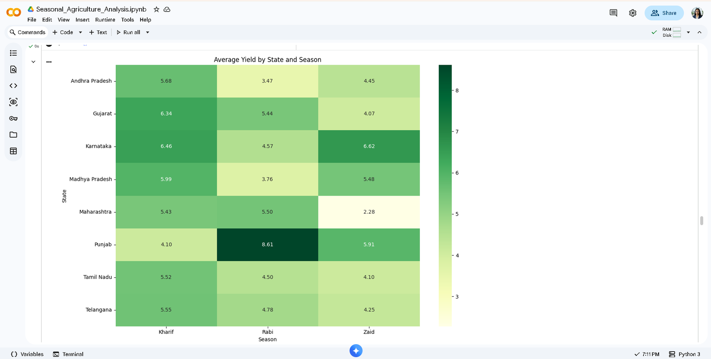
RESULTS
9/6/2026
Annual Review
‹#›

Slide 12
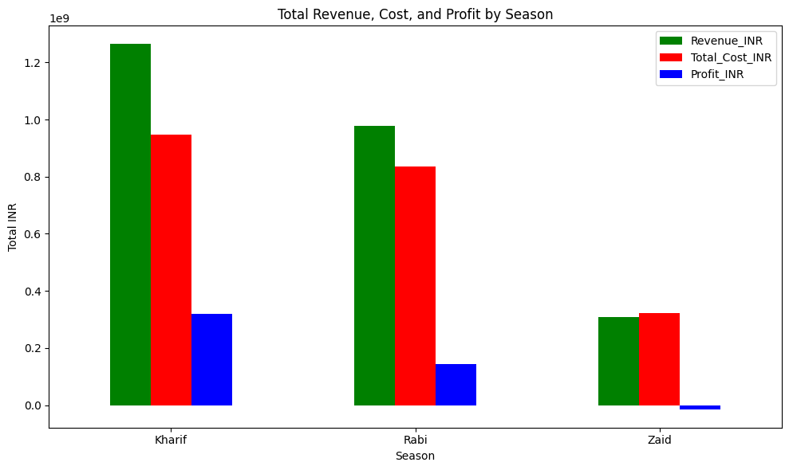
RESULTS
9/6/2026
Annual Review
‹#›

Slide 13
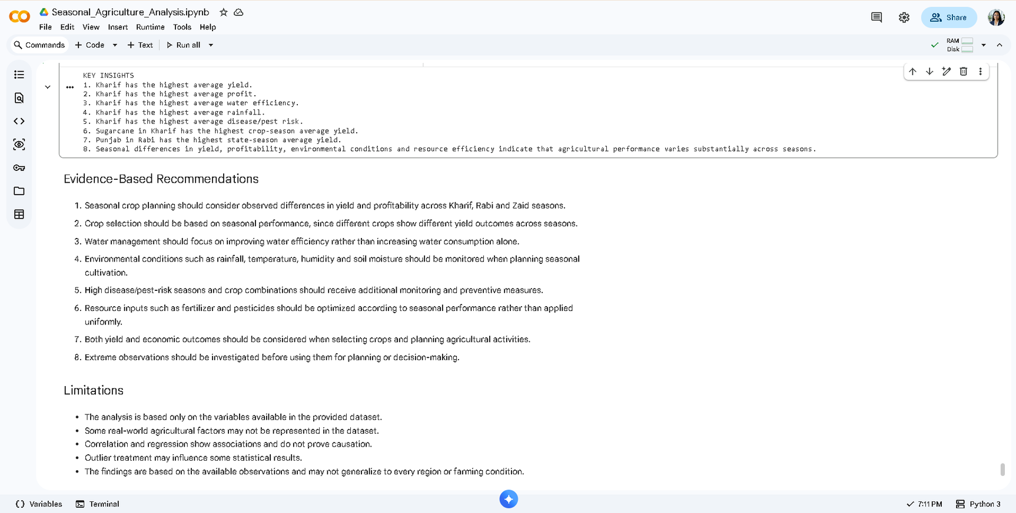
RESULTS
9/6/2026
Annual Review
‹#›

Slide 14
Future scope
  Develop a predictive model for crop yield and profitability
  Add real-time weather and soil data
  Build an interactive agricultural dashboard
  Include more regions and multiple years of data
  Develop crop recommendation based on seasonal conditions
  Explore machine learning for early risk and yield prediction
  Integrate satellite/remote-sensing data for regional analysis
9/6/2026
Annual Review
‹#›

Slide 15
GitHub Link
Github Link :
Github
Notebook
Notebook Link :
9/6/2026
Annual Review
‹#›

Slide 16

VOIS Course completion certificate -
Course name- Data Visualization
9/6/2026
Annual Review
‹#›

Slide 17
Thank you
Our analysis shows that seasonal conditions, crop selection, resource efficiency and regional differences all play an important role in agricultural performance.
.
.
9/6/2026
Annual Review
‹#›

